Slide 1
ADP7182 LFCSP_WD
Change of Product Outline DRAWING

Slide 2
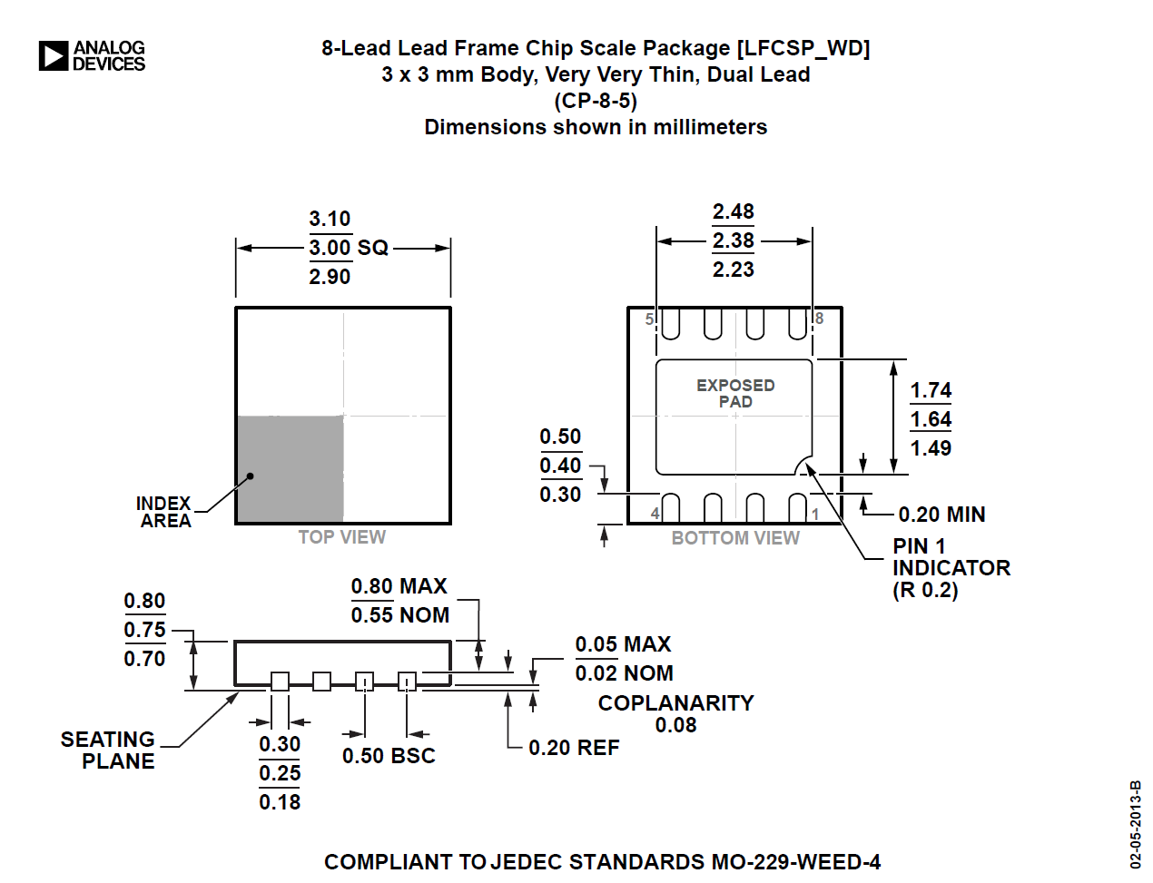
CP-8-5
POD used from previous data sheet (Rev. G)

Slide 3
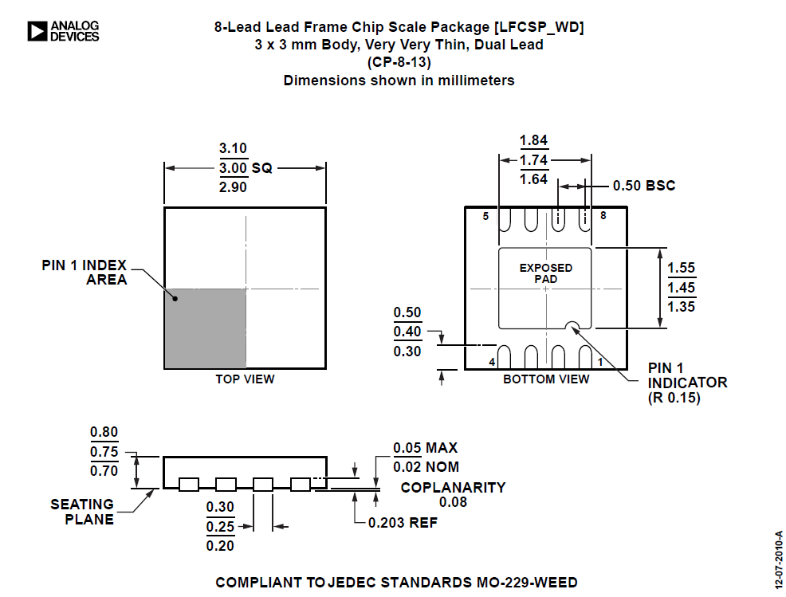
CP-8-13
Current package outline shown on the data sheet (Rev. H)
Correct POD.

Slide 4
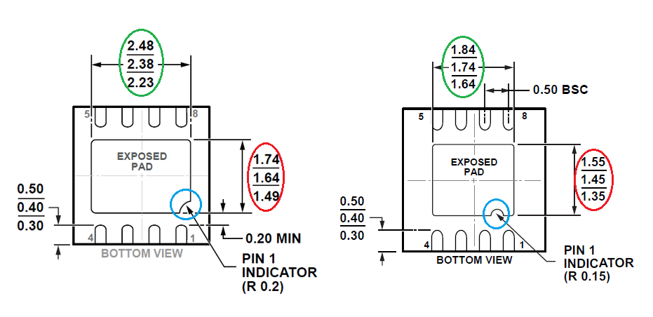
Comparing CP-8-5 versus CP-8-13
Difference in exposed paddle length. 2.38mm for CP-8-5 and 1.74mm for CP-8-13 (nominal).
CP-8-5
CP-8-13
Difference in exposed paddle width. 1.64mm for CP-8-5 and 1.45mm for CP-8-13 (nominal).
Difference in Pin1 indicator.

